Slide 1
Accessibility
WP2 T3

Slide 2
Learning Objectives
Facilitate access to the learning content
Validate accessibility of the learning materials

Slide 3
Agenda
Accessible materials
Standards
Tools
Statement

Slide 4

Accessible learning materials
Designed or later enhanced to be usable across the widest range of learner variability
directly used without assistive technology
made usable with assistive technology
examples
Cultural background
Native language
Learning styles
Physical impairments
This Photo by Unknown Author is licensed under CC BY-NC

Slide 5
General Guidelines
present the information in multiple ways and formats
option to provide additional resources
use headings
use equation editors for math expressions
use a high contrast colour palette
don't use colour as the only way to convey information
use descriptive links
use tables only when required
provide closed captions and transcripts
use simple language
provide alternative text for images
use table of content
How does this reflect on
writing MD content
preparing a slide deck

Slide 6
Standards
W3C Web Content Accessibility Guidelines international standard
WCAG 2.1 (2.2)
4 principles: perceivable, operable, understandable, and robust.
defined success criteria that can be tested
three levels: A (low), AA (mid) and AAA (high)
Compliance = 100% success
PDF/Universal Accessibility (UA)
ISO 14289
enable people independently access all information provided in a PDF document
complementary to the WCAG 2 success criteria

Slide 7
Tools
Checking for accessibility of all generated learning content for learners is required
Aiming for WCAG 2.1(2.2) AA conformance
Web Accessibility Evaluation Tools List generated by W3C
Includes country guidelines filtering
Accessibility evaluation tools are not almighty!

Slide 8
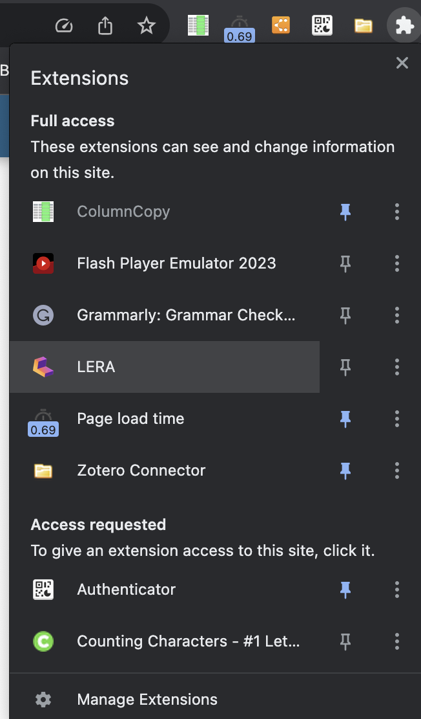
LERA
free browser plugin for Chrome
Available on chrome webstore
direct link to install LERA

Slide 9
Checking accessibility with LERA
Check the accessibility of the NASA Transform to Open Science web site using LERA

Slide 10
Power Point Accessibility
every slide should have a meaningful title
include alternative text for all visuals
slide content should be read in the intended order
descriptive hyperlink text should be used
color should not be the only way of conveying information
sufficient contrast should be used for text and background color
tables should be avoided, or at least be simple with headers
font size should be min 18pts
sans serif fonts should be used
integrated videos should be accessible
export the presentation in an accessible format
Built-in Accessibility Checker Tool
Review -> Check Accessibility

Slide 11
Using the Accessibility Checker Tool
Check the accessibility of the Power Point presentation on Open Science available on OSF: Intro to Open Science - Panelist Slides for upload 3.3.18 at noon taken from Introduction to Open Science: Nuts & Bolts of Getting Started uploaded by Elizabeth Gilbert

Slide 12
PDF/UA
Best way to ensure PDF accessibility is to use Acrobat Pro
integrated accessibility checker
Free option is the axesCheck online tool
upload a PDF file
get a report on the compliance with PDF/UA and WCAG

Slide 13
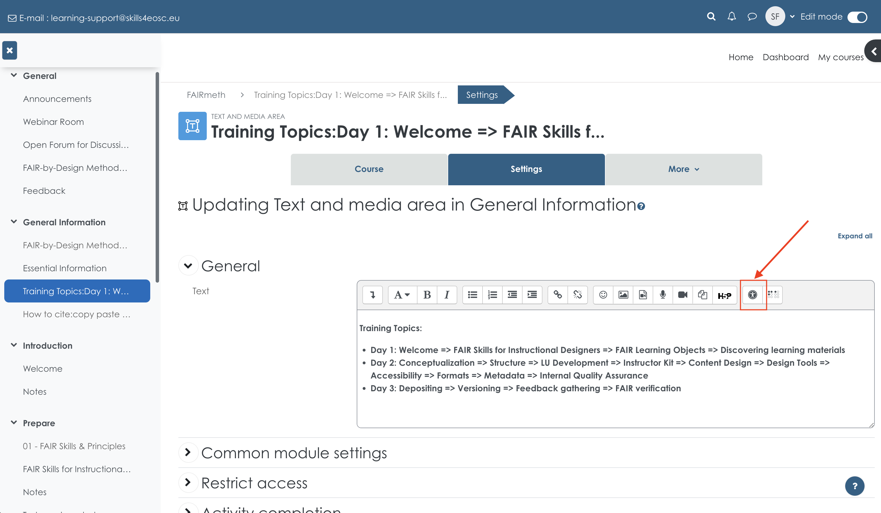
Moodle – Skills4EOSC Learning Platform

Slide 14
Alternative text
Alternative text guide by WebAIM
should be accurate and equivalent in representing content and function
should be concise
do not make it redundant
do not include phrases such as "image of ..." or "graphic of ..."
Decorative image = blank alternative text
does not present important content
is used for layout or non-informative purposes
does not have a function (e.g. is not a link)

Slide 15
Accessibility Statement
mission
measures to support accessibility
conformance status
feedback gathering
compatibility
technical specification
limitations and alternatives
assessment approach
evaluation report and statement
complaints response
Developing an Accessibility Statement – Guide by W3C WAI
Example of Complete Accessibility Statement
We are following a best effort approach

Slide 16
Summary
Check and ensure accessibility as much as possible
Use available tools and best practices
Adhere to standards such as the WCAG
follow the recommendations and rules defined on the country level

Slide 17
Thank you! Any questions before we continue?
sonja.filiposka@finki.ukim.mk
Cite instructions on: https://doi.org/10.5281/zenodo.12604767

